Slide 1


SQL Part 3

Slide 2
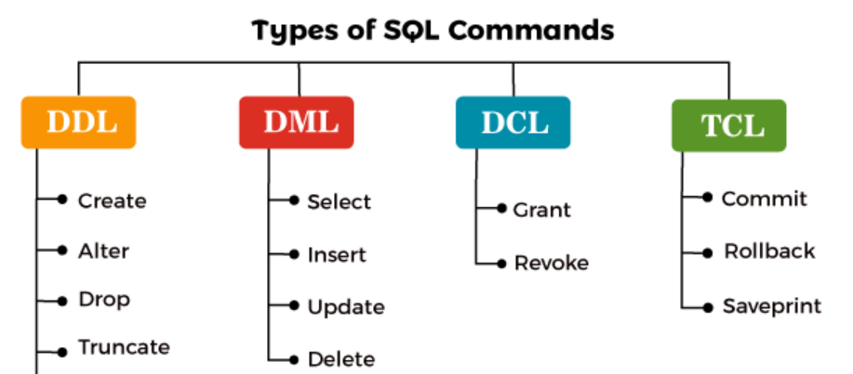

Slide 3
DDL
Create
Drop
Truncate
DML
Insert
Select

Slide 4
Select
Select columns
Select specific columns
Select distinct column values as "all categories" from dataset.
Filtering with WHERE
Basic condition
Multiple conditions with AND
Multiple conditions with OR
Negation with NOT
BETWEEN for range filtering
IN for specific values
Aggregate
Count total rows
Sum of all values in a particular column
Average value of column
Maximum and minimum value of a column

Slide 5
Sorting with ORDER BY
Ascending order
Descending order
Multiple sorting columns
Limiting Results with LIMIT
Retrieve top 10 rows
Skip first 5 rows and fetch next 10
Grouping with GROUP BY
Group by department and count employees
Average salary by country

Slide 6
Filtering Groups with HAVING
Departments with more than 5 employees
Countries with an average salary above 80,000
Functions for Columns-
Mathematical Functions: - Round salary to the nearest thousand
Increase salary by 10
String Functions: Convert names to uppercase
Get the length of each name

Slide 7
Question
Sort employees by salary in ascending order.
Sort employees by salary in descending order.
Sort employees by department in ascending order, and salary in descending order.
Retrieve the top 10 highest-paid employees.
Skip the first 5 rows and retrieve the next 10 rows.
Count the number of employees in each department.
Find the average salary of employees grouped by country. Find the average age of employees grouped by country. Find the total salary given to the departments. Find the total salary given to the departments in every country.

Slide 8
Having Find people where salary >90000 Find departments that have more than 5 employees.
Find countries with an average salary above 80,000.
Round the salaries of employees to the nearest thousand.
Increase all employees' salaries by 10%.
Convert all employee names to uppercase.
Get the length of each employee's name.

Slide 9

Thank you

